Slide 1
Proof of Concept Collaboration #1
Using Cross-jurisdictional Data Linkage to Investigate Cross-Border Hospital Use
Presented by Katrina Spilsbury
Centre for Population Health Research, Curtin University

Slide 2



Why Cross-jurisdictional Linkage of Health Data?
Accurate data for longitudinal studies
  People who move frequently or die interstate
  Seasonal or out of state workers
Increase statistical power to research rare diseases or health outcomes
Evaluate state-based variations in hospital care

Slide 3
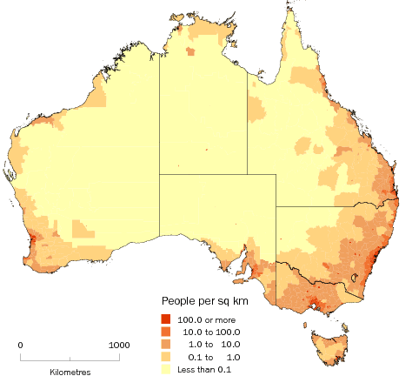
Is cross-border hospital use really an issue?
Darwin
NT
QLD
QLD
Brisbane
WA
SA
Brisbane
NSW
& ACT
Perth
Sydney
Adelaide
VIC
NSW
Melbourne
TAS
Hobart
= Hospital
Source: Australian Bureau of Statistics

Slide 4

PoC #1 – Aims
Epidemiological
  Cross-border hospital use – size of the issue?
  Can cross-jurisdictional linkage refine estimates of hospital-related mortality?
Technical / Logistical
  Data handling and cleaning issues
  Standardisation of data
  What can be improved or streamlined?

Slide 5

PoC #1 – Data
WA, NSW, QLD & SA participating jurisdictions
Five years of data – July 2004 to June 2009
Hospital records
  Public and private hospital in-patient (WA, NSW and QLD)
  Public hospital in-patient (SA)
Death records – WA, NSW, QLD & SA

Slide 6

Data Separation Principle
Centre for Data Linkage
State Data Linkage Units
& Data Custodians
Researcher
Keys
Keys
Key Name Dob
AAA Joe Blow 1930
AAA Joe Blow 1930
AAA Joe Blow 1930
BBB May Wind 1980
BBB May Wind 1980
Year Clinical info
2003 Poorly
2005 Very poorly
2006 Died
2002 1st child
2004 Twins
Keys Names DOB
Keys
XXX
AAA
AAA
AAA
BBB
BBB
YYY
YYY
Name Dob Key
Joe Blow 1930 001
Joe Blow 1930 001
Joe Blow 1930 001
Joe Blow 1930 001
May Wind 1980 002
May Wind 1980 002
May Wind 1980 002
May Wind 1980 002
NSW
Key Year Clinical info
001 2000 Broken arm
001 2003 Poorly
001 2005 Very poorly
001 2006 Died
002 2002 1st child
002 2004 Twins
002 2007 Triplets
002 2008 Exhaustion
Keys
Clinical Info
SA
Keys
Clinical Info
Keys Names DOB
Key Name Dob
XXX Joe Blow 1930
YYY May Wind 1980
YYY May Wind 1980
Year Clinical info
2000 Broken arm
2007 Triplets
2008 Exhaustion
Keys
Keys

Slide 7
Data cleaning
Reformatting file types
Renaming and recoding variables
Applying exclusion criteria
  Funding duplicates, cancelled procedures, boarders, organ procurements, healthy newborns
  Records missing age, sex, principal diagnosis or separation mode
  Non-Australian postcodes of residence.
  1.4 million out of 38 million hospital records
  excluded

Slide 8
Data cleaning by state
Excluded episodes of care (hospital records) | NSW | WA | QLD | SA | Total excluded
Potential funding duplicate records – one kept | 31,345 | 0 | 9,358 | 964 | 20,903
Missing age at admission | 842 | 0 | 0 | 0 | 842
Missing sex or intersex | 199 | 3 | 6 | 3 | 211
Missing principal diagnosis | 28,738 | 0 | 0 | 0 | 28,738
Newborn³, boarder, organ procurement care types | 604,128 | 36,473 | 427,795 | 22,042 | 1,090,438
Non-hospital facility (rehab, nursing, hospices) | 149,416 | 0 | 13,447 | 1,879 | 164,742
Non-medical hospital encounter (Z76) | 1,899 | 4,137 | 1,496 | 760 | 8,292
Cancelled procedures (Z53) | 1,609 | 0 | 35 | 0 | 1,644
Missing, unknown or overseas postcodes | 84,888 | 8,412 | 30,788 | 3,267 | 127,355
Separation date < admission date or missing | 125 | 0 | 0 | 0 | 125
Total excluded | 903,189 | 49,025 | 482,925 | 28,915 | 1,443,290

Slide 9
Coding variation between states
 | NSW |  | WA |  | QLD |  | SA
 | N | % | N | % | N | % | N | %
Day case chemotherapy (Z51.1)
Public hospital | 26,784 | 11.5 | 150,826 | 53.5 | 180,891 | 36.0 | 63,606 | 100
Private hospital | 206,693 | 88.5 | 131,011 | 46.5 | 321,812 | 64.0 | -
Day case renal dialysis (Z49.1)
Elective | 1,606,258 | 91.5 | 0 | 0 | 57,316 | 4.7 | 0 | 0
Emergency | 12,581 | 0.7 | 0 | 0 | 290 | 0.02 | 0 | 0
Not assigned | 136,494 | 7.8 | 729,104 | 100 | 1,159,719 | 95.3 | 313,774 | 100.0
Single delivery (O80)
Elective | 25,798 | 30.4 | 0 | 0.0 | 1,866 | 2.7 | 0 | 0.0
Emergency | 2,155 | 2.5 | 0 | 0.0 | 6,472 | 9.5 | 0 | 0.0
Not assigned | 57,029 | 67.1 | 23,983 | 100.0 | 59,521 | 87.7 | 11,205 | 100.0
ED deaths recorded as in-patient | Yes |  | No |  | No |  | No

Slide 10
PoC #1 – Findings
Acute care hospital stays
  Multi-episodes of care (records) bought together
  SA – Public Hospitals only
 | NSW |  | WA |  | QLD |  | SA |  | Total
 | N | % | N | % | N | % | N | %
All Hospital stays | 8,723,879 | 46.2 | 2,799,646 | 14.8 | 5,919,025 | 31.4 | 1,427,780 | 7.6 | 18,870,330
All Individuals | 3,660,991 | 47.9 | 1,094,303 | 14.3 | 2,286,449 | 30.0 | 608,921 | 8.0 | 7,650,664
Public Hospital Stays
In-hospital deaths | 95,735 | 1.8 | 19,177 | 1.2 | 40,929 | 1.4 | 20,073 | 1.4 | 175,913
30 day deaths | 30,733 | 1.4 | 6,409 | 1.1 | 12,047 | 1.1 | 7,922 | 1.3 | 66,324

Slide 11
Hospital Stays by Travellers
223,262 (3.0%) individuals who had 352,969 (1.9%) hospital stays as traveller
Residence | Jurisdiction of hospital stay
 | NSW | WA | QLD | SA | Total
NSW | - | 3,111 | 131,149 | 5,986 | 140,246
WA | 3,550 | - | 2,536 | 1,260 | 7,346
QLD | 65,506 | 2,612 | - | 1,606 | 69,724
SA | 3,798 | 1,195 | 2,964 | - | 7,957
VIC | 59,967 | 2,716 | 12,131 | 9,594 | 84,408
TAS | 2,269 | 418 | 1,850 | 369 | 4,906
NT | 1,890 | 1,593 | 3,862 | 8,627 | 15,972
ACT | 20,871 | 189 | 1,128 | 222 | 22,410
Total | 157,851 (1.81%) | 11,834 (0.42%) | 155,620 (2.63%) | 27,664 (1.94%) | 352,969 (1.87%)

Slide 12
Residence of Travellers
Jurisdiction of residence

Slide 13
Hospital Stays by Movers
There were 48,575 (0.6%) individuals with 59,387 hospital stays recorded as movers
Pre-move residence | Jurisdiction of post-move residence
 | NSW | WA | QLD | SA | Total
NSW | - | 3,719 | 19,549 | 1,832 | 25,100
WA | 2,854 | - | 3,988 | 1,168 | 8,010
QLD | 12,835 | 3,143 | - | 1,520 | 17,498
SA | 1,568 | 1,173 | 1,917 | - | 4,658
VIC | 970 | 216 | 591 | 286 | 2,063
TAS | 105 | 35 | 94 | 15 | 249
NT | 154 | 220 | 299 | 257 | 930
ACT | 700 | 34 | 125 | 20 | 879
Total | 19,186 (0.22%) | 8,540 (0.31%) | 26,563 (0.45%) | 5,098 (0.36%) | 59,387 (0.31%)

Slide 14
Residence of Movers
Jurisdiction pre-move
Note: By definition a mover had at least 2 hospital stays over a 5 year period

Slide 15
Cross-border hospital transfers
Over 11,000 acute care hospital transfers across state borders of the four jurisdictions were identified
Jurisdiction of sending hospital | Jurisdiction of receiving hospital
 | NSW | WA | QLD | SA | Total
NSW | - | 12 | 8,114 | 1,316 | 9,442
WA | 27 | - | 26 | 12 | 65
QLD | 1258 | 8 | - | 12 | 1,278
SA | 299 | 8 | 24 | - | 331
Total | 1,584 | 28 | 8,164 | 1,340 | 11,116

Slide 16
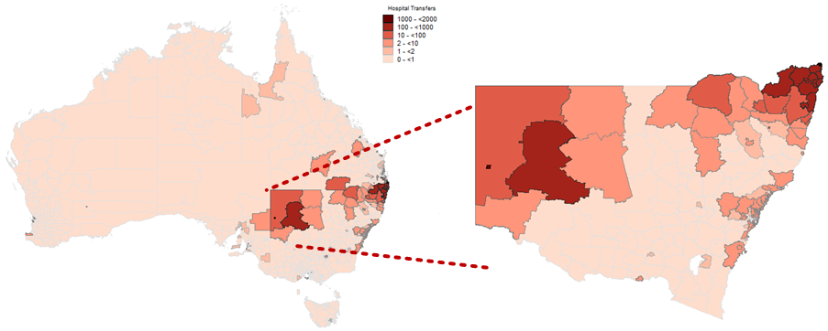
Cross-border hospital transfers
Jurisdiction of sending hospital

Slide 17
Conclusion
Cross-border hospital use
  SA & QLD receive highest proportions of patients from elsewhere
  Mining / tourism regions in QLD & WA have high numbers of movers
Cross-jurisdictionally linked data is complex!
  Very large files
  Takes time to understand
  Local knowledge and input essential
  Centralised approach to data and metadata?

Slide 18
PoC #1 - Contributors
Research team (WA)
Katrina Spilsbury & Janine Alan – Centre for Population Health Research, Curtin University
Di Rosman – WA Health
New South Wales
Lee Taylor, Kim Lim, Baohui Yang and Zoran Bolevich– NSW Ministry of Health
South Australia
Almond Sparrow and Stacy Vasquez – SA NT Data Link
Paul Basso, Tina Hardin & Tomi Adejoro – SA Health
Helen Paues – SA Births Deaths and Marriages
Darren Shaw – Promadis
Western Australia
Jessica Lee, Alex Godfrey, Paul Stevens & Carol Garfield - WA Health
Brett Burns – WA Births, Deaths & Marriages,
Centre for Data Linkage (WA)
Anna Ferrante, James Boyd, Sean Randall & Jacqui Bauer
Queensland
Ben Wilkinson, Trisha Johnston & Ann Harrington– QLD Health
Julie Hall and Erica Findlay – QLD Births Deaths Marriages,
PHRN Program Office
Merran Smith, Felicity Flack, Angela Young, Nathalie Wray,
Emma Fuller & Tony Woollacott
Others
Vicky Stagg - University of Calgary, Canada
James Harrison – Flinders University
Bruce Armstrong – University of Sydney
Neville Board – ACSQHC
Robyn Munro & Alan Finlayson – NS, Scotland
Sanja Lujic – University of Western Sydney
This project was jointly supported by the Australian Government’s National Collaborative Research Infrastructure Strategy and the Western Australian Department of Commerce

